Slide 1
Augmenting
Advantages over original:
Validates approximation quality
Bounds sandwich the optimal solution
Works on large graphs where exact solution isn't feasible
Helps identify when approximation is close to optimal
Both bounds computable efficiently
Lower bound ≤ Optimal solution ≤ Approximation ≤ Upper bound

Slide 2
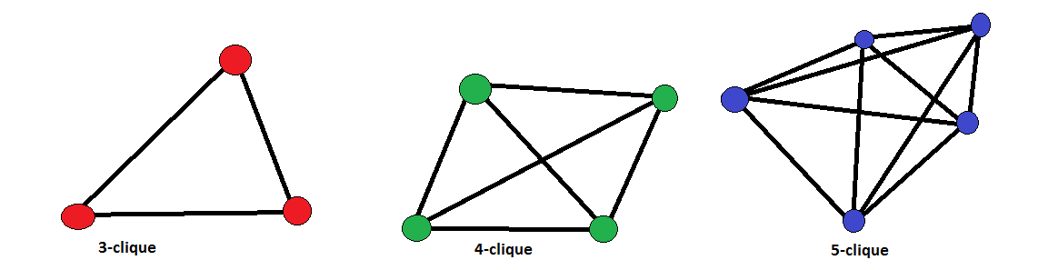
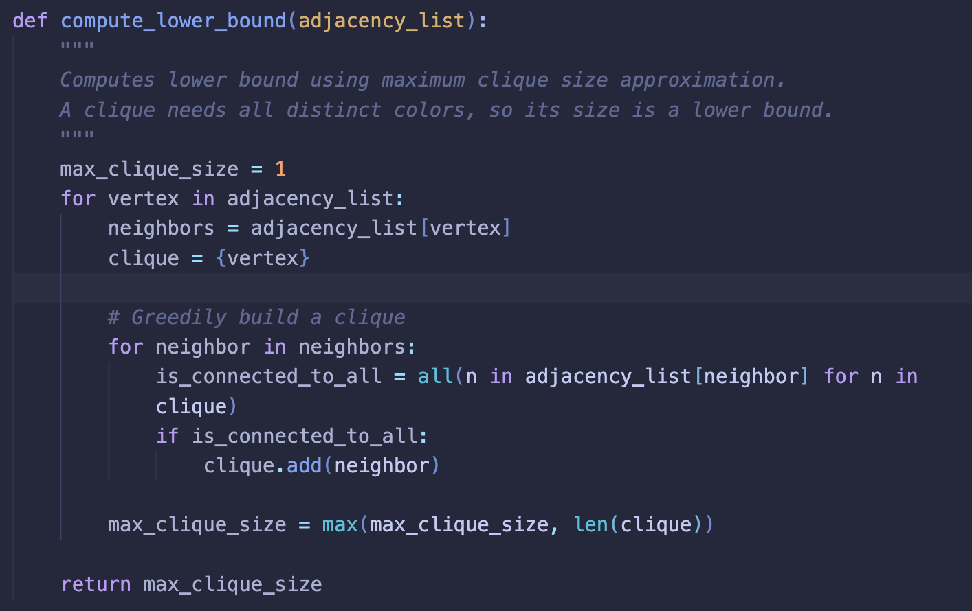
Lower Bound (Maximum Clique):
Finds largest fully-connected subgraph greedily
Must use different colors for each vertex in a clique
If we find a clique of size k, chromatic number ≥ k
O(V²) complexity but gives guaranteed minimum colors needed
Every vertex in a clique must have a different color (they're all connected)
Therefore, clique size is a lower bound for chromatic number
Start with single vertex
Add neighbors connected to all current clique vertices
Track largest clique found

Slide 3
Upper Bound (Brook’s Theorem)
Brook’s Theorem states that:
If G is a connected simple graph and is neither an odd cycle nor a complete graph i.e. χ(G) ≥ 3 then
χ(G) ≤ k, where k denotes the maximum degree of G and χ(G) denotes the chromatic number of G.
We use Brook’s Theorem instead of |V| as it gives us a tighter bound.
Using |V| as an upper bound is trivial since for every graph, we can color with V-coloring.
For example, a graph with 10 vertices:
Upper-bound by |V|: Always 10
Upper-bound by Brooks: Could be 4 or 5 for non-complete graphs

Slide 4
Bound correctness
Lower Bound (Clique Number)
Computation: Finds approximate maximum clique size using greedy algorithm
Correctness Proof:
All vertices in a clique must have different colors (they're all connected)
Therefore, minimum colors needed ≥ size of largest clique
Thus, our value is always ≤ optimal chromatic number
Upper Bound (Brooks' Theorem)
Computation: maximum degree + 1
Correctness Proof:
Brooks' Theorem states: For connected graph G that's not complete or odd cycle, χ(G) ≤ Δ(G)
Adding 1 to maximum degree always gives valid upper bound
Simple to compute: just find max length in adjacency lists
Both bounds are polynomial time:
Lower bound: O(V²Δ)
Upper bound: O(V)

Slide 5
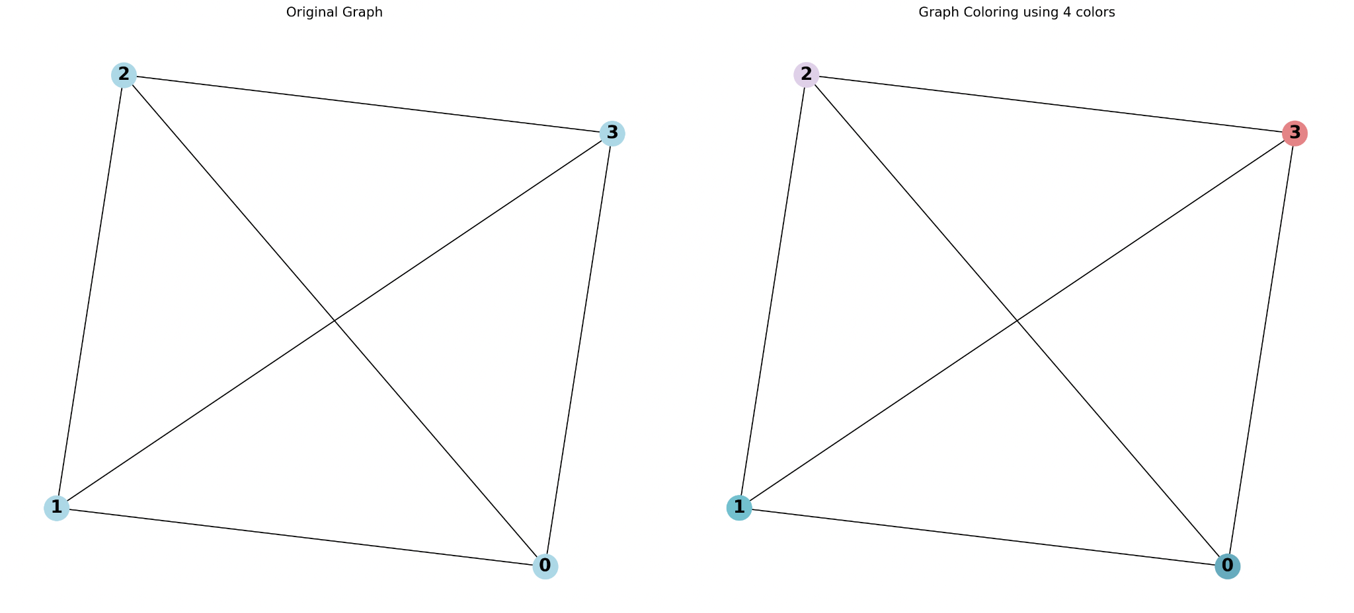
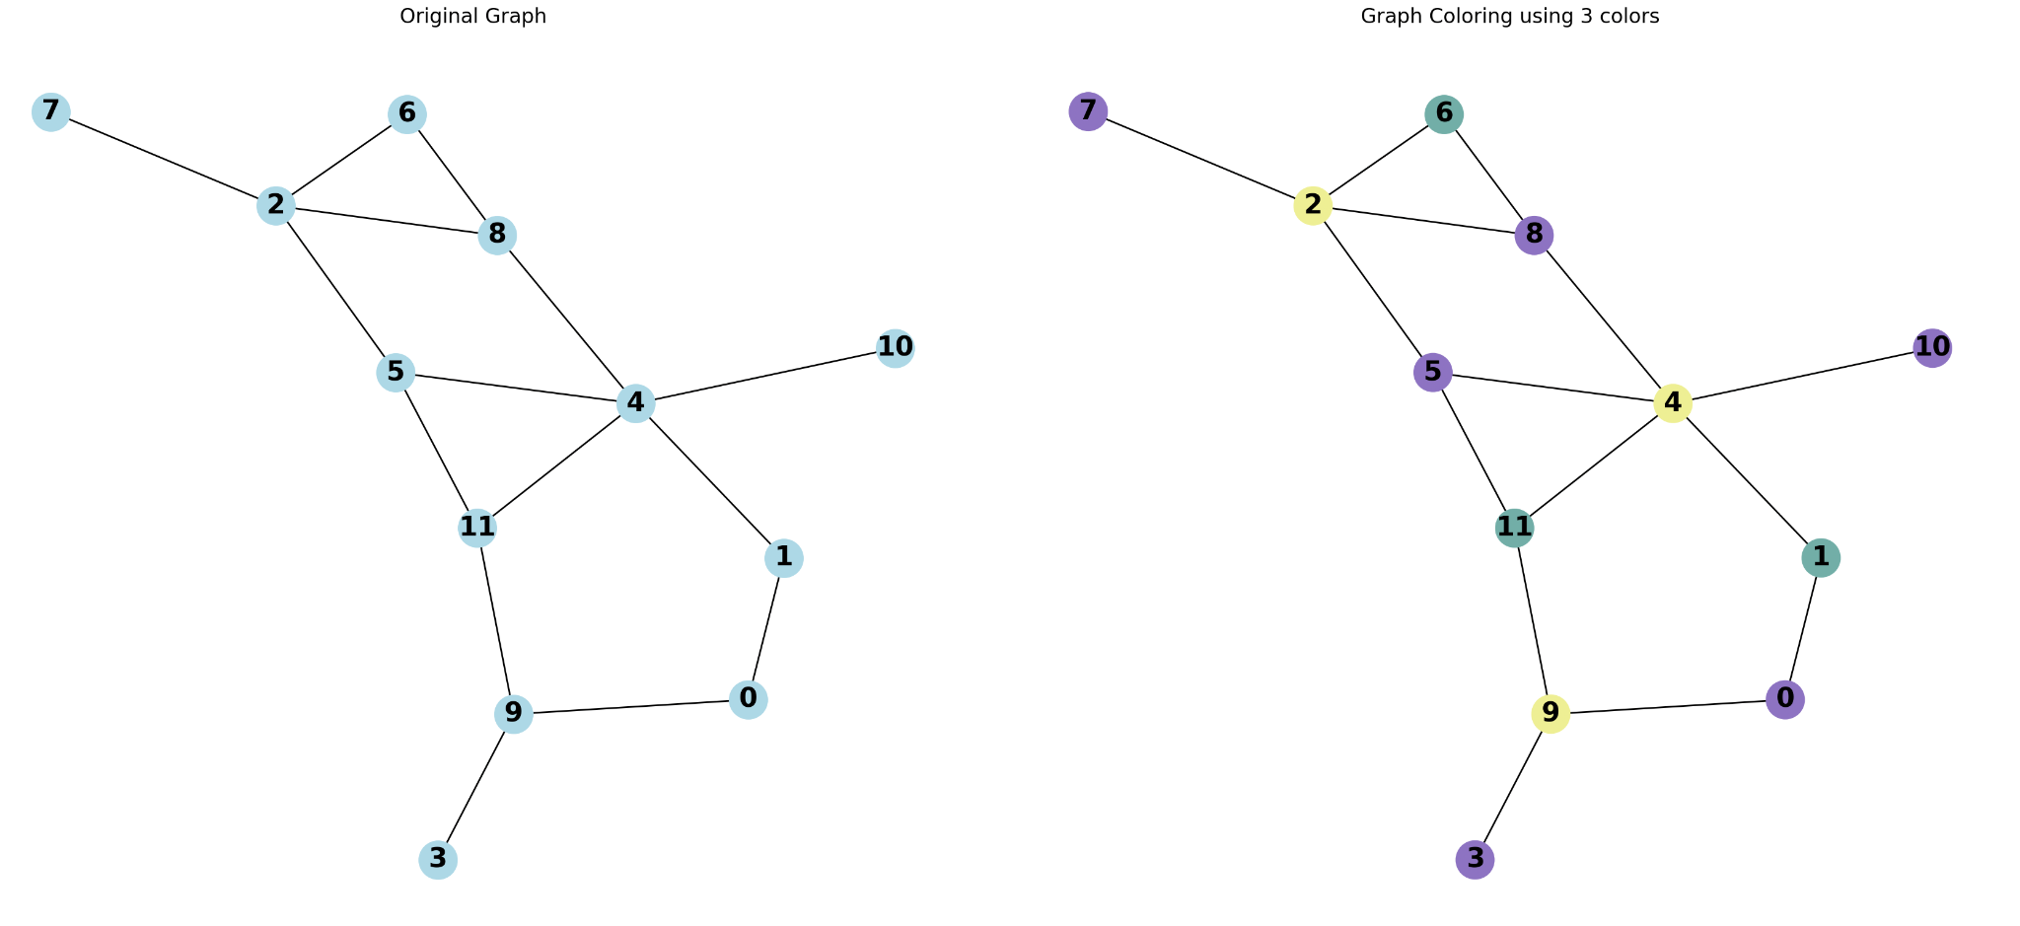
Test Case | Vertices | Edges | Lower Bound | Approx | Upper Bound | Exact χ(G)
small_optimal | 4 | 6 | 4 | 4 | 4 | 3
small_nonoptimal | 5 | 4 | 2 | 2 | 3 | 2
medium_optimal | 10 | 45 | 10 | 10 | 10 | 7
medium_nonoptimal | 12 | 15 | 3 | 3 | 6 | 4
large_nonoptimal | 60 | 200 | 4 | 5 | 13 | N/A
small_optimal
medium_nonoptimal

